Slide 1
Computer Architecture I
CS-GY-6133
Topic: Caches
Instructor: Siddharth Garg

Slide 2
Cache Organization
Caches store data in chunks of “cache blocks”
Access to a cache returns an entire cache block
A block can be as small as 1 byte, but can be larger (example: 4 bytes)
Where does a block go when it is fetched into cache? (Placement)
How do we know if a block already exists in the cache? (Identification)
Which block should we kick out if there isn’t enough room? (Replacement)
32 KB cache
1 Byte cache block
i.e., 32768 blocks
32 bit address
from CPU

Slide 3
Direct Mapped Cache
Assume 32 KByte cache with a 1 Byte cache block
1 Byte = 8 bits
Block 0
Address 0, 32768, 2*32768, …
Block 1
Address 1, 32769, 2*32768+1, …
Block 2
Address 2, 32770, 2*32768+2, …
32 bit address
from CPU
Block 32767
Address 32767, 65535, …

Slide 4
Direct Mapped Cache: Placement
Each block in the cache has a log₂(32768) = 15 bit “index”
Index
Block 0
Address 0, 32768, 2*32768, …
32 bit address
from CPU
Block 1
Address 1, 32769, 2*32768+1, …
Block 2
Address 2, 32770, 2*32768+2, …
Index
(15 bits)
15 LSBs of address are used to look up (index) into the cache
Block 32767
Address 32767, 65535, …

Slide 5
Direct Mapped Cache: Identification
32 bit address
Data Array
(8 bits)
Tag Array
(17 bits)
Tag
(17 bits)
Index
(15 bits)
Block 0
Tag 0
Addr 0
0…………………….00
0….00
Block 1
Tag 1
Addr 32768
0…………………….01
0….00
Block 2
Tag 2
How do we know which block of data is stored?
Addr ….
1…………………….11
0….00
Block 32767
Tag 32767

Slide 6
Direct Mapped Cache: Replacement
32 bit address
Data Array
(8 bits)
Tag Array
(17 bits)
Tag
(17 bits)
Index
(15 bits)
Data[0]
0…………… 00
Data[32768]
Tag 0
Block 0
0…………… 01
Access 1
0…………………….00
0….00
Miss
Block 1
Tag 1
Data[32769]
0…………… 00
Access 2
0…………………….00
0….00
Hit
Block 2
Tag 2
Access 3
0…………………….01
0….00
Miss
Access 4
0…………………….00
0….01
Miss
Block 32767
Tag 32767

Slide 7
Direct Mapped Cache: Replacement
32 bit address
Data Array
(8 bits)
Tag Array
(17 bits)
Valid
(1 bit)
Tag
(17 bits)
Index
(15 bits)
Data[0]
1
Data[32768]
Tag 0
Block 0
0…………… 00
0
Access 1
0…………………….00
0….00
Miss
0
Block 1
Tag 1
1
Data[32769]
0…………… 01
Access 2
Block 2
Tag 2
0…………………….00
0….00
Hit
Access 3
0…………………….01
0….00
Miss
Block 32767
Tag 32767
0

Slide 8
Cache Operation
Data Array
(8 bits)
Tag Array
(17 bits)
Valid
(1 bit)
Address (32 bits)
Tag
(17 bits)
Index
(15 bits)
Block 0
Tag 0
V 0
0
Block 1
Tag 1
0
V 1
Block 2
Tag 2
V 2
Block 32767
Tag 32767
V..
1
=
&
0
0
MISS
Output Data if HIT
1
HIT

Slide 9
Alternative Placement
Assume 32 KByte cache with a 1 Byte cache block
1 Byte = 8 bits
Use 15 MSBs of address to determine index
Consider following stream of accesses:
Addr 0, Addr 1, Addr 0, Addr 1,..
“Conflict Misses”
Block 0
Address 0, 1, 2, 3, …..
Block 1
Address 32678, ….
Block 2
Bad Idea!
Block 32767

Slide 10
Set Associative Caches
Direct mapped caches can have miss rate due to conflicts
Each address maps to a unique location in the cache
Assume addresses A and B with same index bits
Sequence: A, B, A, B, A….. results in 100% cache miss rate!
Set-associative cache: each address can map to N different locations in the cache!
“N-way” set associative cache
2-way set associate cache has ~0% cache miss rate for sequence A, B, A, B …

Slide 11
2-Way Set Associative Cache
2-way set-associative 32 KB cache with 1 Byte blocks
Data Array
(8 bits)
Tag Array
(? bits)
Valid
(1 bit)
Data Array
(8 bits)
Tag Array
(? bits)
Valid
(1 bit)
Set 0
Set 1
Set 16383
Way 0
Way 1

Slide 12
Placement
Tag
(? bits)
Index
(14 bits)
Tag
(18 bits)
Index
(? bits)
Data mapped to a unique set but can be placed in either way
Data Array
(8 bits)
Tag Array
(? bits)
Valid
(1 bit)
Data Array
(8 bits)
Tag Array
(? bits)
Valid
(1 bit)
Set 0
Set 1
Set 16383
Way 0
Way 1

Slide 13
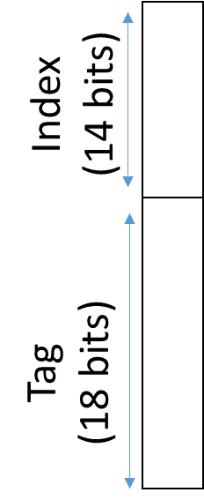
Identification
Way 0
Way 1
Data Array
(8 bits)
Tag Array
(18 bits)
Valid
(1 bit)
Data Array
(8 bits)
Tag Array
(18 bits)
Valid
(1 bit)
=
&
=
&
HIT?
HIT?

Slide 14
Replacement
(Addresses A, B, C map to same set)
Way 0
Way 1
Data Array
(8 bits)
Tag Array
(18 bits)
Valid
(1 bit)
Data Array
(8 bits)
Tag Array
(18 bits)
Valid
(1 bit)
Data[A]
Tag[A]
1
Data[B]
Tag[B]
1
Sequence: A B B A A A A C
Where should C go?
M
M
H
H
H
H
H
M

Slide 15
Least Recently Used (LRU)
Way 0
Way 1
Data Array
(8 bits)
Tag Array
(18 bits)
Valid
(1 bit)
Data Array
(8 bits)
Tag Array
(18 bits)
Valid
(1 bit)
Data[A]
Data[B]
Tag[B]
1
Tag[A]
1
Data[C]
Tag[C]
Evicted!
Sequence: A B B A A A A C
Replace least recently used block
M
M
H
H
H
H
H
M

Slide 16
Implementing LRU
Way 0
Way 1
Data Array
(8 bits)
Tag Array
(18 bits)
Valid
(1 bit)
Data Array
(8 bits)
Tag Array
(18 bits)
Valid
(1 bit)
MRU
(1 bit)
Tag[B]
1
1
Data[A]
0
Tag[A]
1
Data[B]
0
Sequence: A B B A A A A C
LRU = NOT MRU
M
M
H
H
H
H
H
M

Slide 17
Practical LRU Implementation
LRU is hard to implement in hardware for N>2
Keep track of all possible N! orderings of N ways
A linked list in which the head points to MRU and tail points to LRU
Example: N=4; 4 x 2 bits = 8 bits per cache set and extra logic to update list on every access
Alternative policies that are more hardware friendly
NOT MRU: same as LRU for N=2, requires only log(N) bits, easy update
Hierarchical: for N=4, divide ways into 2 groups of 2 ways

Slide 18
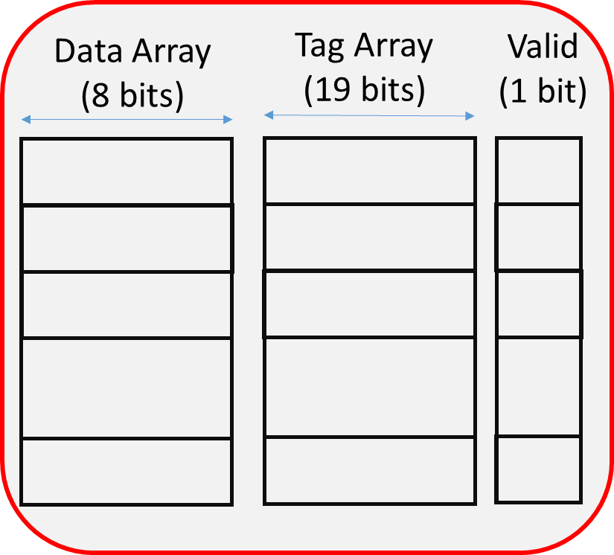

Hierarchical LRU Implementation
MRU Way
(G0)
MRU Way (G1)
Way 0
Way 1
Way 2
Way 3
MRU Grp
A
B
C
D
Group 0
Group 1
Sequence | A | C | D | B | A | A | E
MRU Grp | 0 | 1 | 1 | 0 | 0 | 0
MRU Way (G0) | 0 | 0 | 0 | 1 | 0 | 0
MRU Way (G1) | - | 2 | 3 | 3 | 3 | 3
Which block is evicted?

Slide 19
Hierarchical LRU Implementation
MRU Way
(G0)
MRU Way (G1)
Way 0
Way 1
Way 2
Way 3
MRU Grp
A
B
C
D
Group 0
Group 1
Sequence | A | C | D | B | A | D | E
MRU Grp | 0 | 1 | 1 | 0 | 0 | 1
MRU Way (G0) | 0 | 0 | 0 | 1 | 0 | 0
MRU Way (G1) | - | 2 | 3 | 3 | 3 | 3
Which block is evicted?
Not the true LRU block!

Slide 20
Exploiting Spatial Locality
Tag
(17 bits)
Index
(12 bits)
Offset
(3 bits)
Recall that if the byte from address i is accessed, then byte from address i+1 is likely to be accessed
Pull in multiple contiguous bytes of data in each access
Use larger block size!
Example: 32KB direct mapped cache with 8 Byte (64 bit) blocks
i.e., cache has 4096 Byte blocks
Selects a byte from the block
Selects a block
Tag 0
Block 0
Block 1
Tag 4095
Block 4071
Valid
Tag Array
(17 bits)
Data Array
(8 bytes)

Slide 21
Cache Operation
Data Array
(8 bytes)
Tag Array
(17 bits)
Valid
(1 bit)
Address (32 bits)
Tag
(17 bits)
Index
(12 bits)
Offset
(3 bits)
Block 0
Tag 0
V 0
0
Block 1
Tag 1
0
V 1
Block 2
Tag 2
V 2
Block 4095
Tag 4095
V..
8 Bytes
1
=
&
0
0
8:1 MUX
MISS
Output Data if HIT
1 Bytes
1
HIT

Slide 22
Impact of Block Size
Sequence of addresses: A, A+1, A+2, A+3 …
4 consecutive misses for 1 byte block size
1 miss and 3 hits for 4 byte block size
Small block sizes don’t exploit any spatial locality
What happens if the block size increases for the same cache size
Fewer number of larger blocks
[Source: D Brooks CS146 Lecs]

Slide 23
In Class Exercise 1
Determine the number of offset bits, index bits and tag bits for a 4-way, 8KB cache with 8 Byte blocks. Assume that the cache is Byte addressable with a 32 bit address.
Offset: 3 bits (8 byte blocks that are byte addressable)
Number of sets: 2¹³ bytes / ( 4 ways x 8 bytes per way) = : 2¹³ bytes / 2⁵ bytes = 2⁸ sets
Index: 8 bits
Tag: 32 – 8 – 3 = 21 bits

Slide 24
Write Policies
What should we do on a cache store/write access
Cannot perform tag look-up and data-array lookup in parallel (why?)
First access tag array and if there is a write hit, write to the data array
Increases the delay of a cache access (recall: period is determined by the worst-case)
What do on a write hit?
When there is a tag match (i.e., block exists in cache)
What to do on a write miss?
When the data block is not in the cache?

Slide 25
Write Hit Policies
When to propagate new (“dirty”) values to lower levels
Write-back policy: lazy, take care of it later
Write-through policy: update lower levels immediately
Write-back policy
Modify the data in the current cache level only
When to update the data in the lower level? When cache block is evicted
Dirty bit per cache block to keep track of blocks that have been updated
Pros
Write happens at speed of current cache level
multiple writes to the same block result in only one write back to main memory
Cons
Evictions take more time
Data inconsistency between cache and lower levels

Slide 26
Write Back Cache (32 KB, Direct Mapped, 1 Byte Block)
Data Array
(8 bits)
Dirty
(1 bit)
Tag Array
(17 bits)
Valid
(1 bit)
Write Address (32 bits)
Tag
(17 bits)
Index
(15 bits)
Block 0
D 0
Tag 0
V 0
0
0
Block 1
0
Tag 1
0
D 1
V 1
Block 2
1
Tag 2
V 2
0
Block 32767
Tag 32767
V..
Write Data
(8 bits)
1
=
&
1
HIT

Slide 27
Write Back Cache (32 KB, Direct Mapped, 1 Byte Block)
Data Array
(8 bits)
Dirty
(1 bit)
Tag Array
(17 bits)
Valid
(1 bit)
Read Address (32 bits)
Tag
(17 bits)
Index
(15 bits)
Block 0
D 0
Tag 0
V 0
0
0
Block 1
0
Tag 1
0
D 1
V 1
DISCARD DATA
Tag 2
1
Block 2
0
Block 32767
Tag 32767
V..
0
=
&
0
MISS

Slide 28
Write Back Cache (32 KB, Direct Mapped, 1 Byte Block)
Data Array
(8 bits)
Dirty
(1 bit)
Tag Array
(17 bits)
Valid
(1 bit)
Read Address (32 bits)
Tag
(17 bits)
Index
(15 bits)
Block 0
D 0
Tag 0
V 0
0
0
Block 1
0
Tag 1
0
D 1
V 1
Block 2
1
Tag 2
1
Block 32767
Tag 32767
V..
0
=
&
WRITE-BACK DATA
0
MISS

Slide 29
Write Back Cache (32 KB, Direct Mapped, 1 Byte Block)
Data Array
(8 bits)
Dirty
(1 bit)
Tag Array
(17 bits)
Valid
(1 bit)
Write Address (32 bits)
Tag
(17 bits)
Index
(15 bits)
Block 0
D 0
Tag 0
V 0
0
0
Block 1
0
Tag 1
0
D 1
V 1
Block 2
1
Tag 2
V 2
1
Block 32767
Tag 32767
V..
Write Data
(8 bits)
1
=
&
1
HIT

Slide 30
Write Hit Policies
When to propagate new (“dirty”) values to lower levels
Write-back policy: lazy, take care of it later
Write-through policy: update lower levels immediately
Write-Through policy
Update lower levels of cache/memory on every write
No need for a dirty bit in the cache
Pros
Reduces complexity of cache (no dirty bit)
Reads never cause write-backs
Consistency across levels of memory hierarchy
Cons
Increased write bandwidth (multiple writes to same block)
Potentially Increased write latency (wait for write to propagate to lower levels?)

Slide 31
Write Through Cache (32 KB, Direct Mapped, 1 Byte Block)
Data Array
(8 bits)
Tag Array
(17 bits)
Valid
(1 bit)
Write Address (32 bits)
Tag
(17 bits)
Index
(15 bits)
Block 0
Tag 0
V 0
0
Block 1
Tag 1
0
V 1
Block 2
Tag 2
V 2
Update data in cache
Block 32767
Tag 32767
V..
Write Data
(8 bits)
1
=
&
Write-Through to Lower Level
1
HIT

Slide 32
Write Through Cache (32 KB, Direct Mapped, 1 Byte Block)
Data Array
(8 bits)
Tag Array
(17 bits)
Valid
(1 bit)
Read Address (32 bits)
Tag
(17 bits)
Index
(15 bits)
Block 0
Tag 0
V 0
0
Block 1
Tag 1
0
V 1
Block 2
Tag 2
1
DISCARD DATA
Block 32767
Tag 32767
V..
0
=
&
0
MISS

Slide 33
Write Buffers

Slide 34
Write Miss Policies
What to do if a write access misses in the cache
Write allocate policy
Write no-allocate policy
Write-allocate Policy
Treat like a read miss, allocate block in cache for data
Standard write hit actions follow
Good match for write-back caches
Write no allocate Policy
Do not allocate a cache block for the write, instead forward write to the next level
This implies that only a read access will result in allocations
Goes well with write through policy

Slide 35
Summary of Write Policies
Write Policy | Hit/Miss | Where is Update Performed
Write Back, Allocate | Hit/Miss | L1
Write Back, No Allocate | Hit
Write Back, No Allocate | Miss
Write Through, Allocate | Hit/Miss
Write Through, No Allocate | Hit
Write Through, No Allocate | Miss
L1
L2
L1 and L2
L1+L2
L2

